Slide 1
Definition Of Thermodynamic Terms

Slide 2
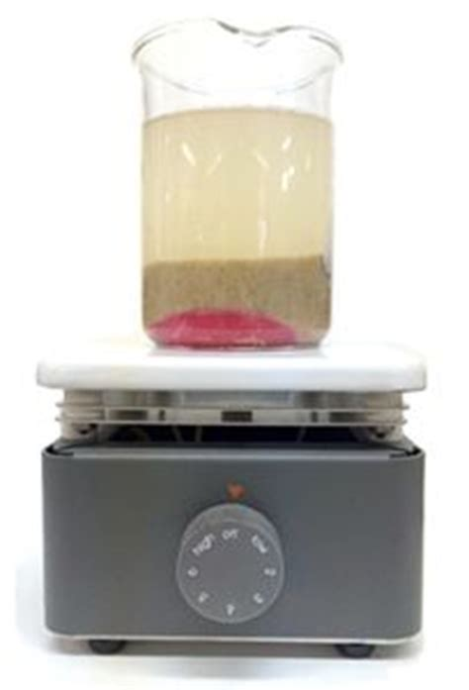
System and surrounding

Slide 3
System
A thermodynamic system is that part of the physical universe the properties of which are under investigation.

Slide 4
Surrounding
The system is confined to a definite place in space by the boundary which separates it from the rest of the universe, the surrounding

Slide 5
Types of System
Isolated System:
A system is called isolated when neither energy nor mass can passes the boundary
Or
An isolated system produces no observable effect or disturbance in its surrounding
2. Closed System
A system is called closed when no mass passes the boundary
3. Open System
A system is called open when mass passes across the boundary

Slide 6
T₁
T₂
Heat Q
T₁>T₂
After Some Time T₁=T₂

Slide 7
Heat
The attainment of thermal equilibrium of two systems by asserting that a quantity of heat Q has flowed from the system of higher temperature to the system of lower temperature.

Slide 8
Properties of Heat
Heat appears only at the boundary of the system
Heat appears only during a change in state.
Heat manifested by an effect in the surrounding
Heat is positive if the surrounding is cooled i.e. heat has flowed from the surrounding, and negative if the surrounding is warmed i.e heat has flowed to the surrounding
T₂
Surrounding
Q
System
T₁

Slide 9
Work
M
M
Piston
V₂
V₁

Slide 10
Work (W) is defined as any quantity that flows across the boundary of a system during a change in state and is completely convertible into lifting of a weight in the surrounding.

Slide 11
Properties of work
Work appears only at the boundary of the system.
Work appear only during a change in state.
Work manifested by an effect in the surrounding.
Work is negative if the mass is lifted, i.e. work has flowed to the surrounding or work is done by the system and positive if the mass is lowered i.e. work has flowed from the surrounding or work is done on the system

Slide 12
M
M
V₂
V₁
W is negative

Slide 13
M
M
V₂
V₁
W is positive

